Slide 1
9 Databases
Define a single-table database from given data
Suggest suitable basic data types •
Understand the purpose of a primary key and identify a suitable primary key for a given database table
Read, understand and complete structured query • language (SQL) scripts to query data stored in a single database table
Including: – fields – records – validation Including:
– text/alphanumeric – character – Boolean – integer
– real – date/time
Limited to:
– SELECT
– FROM
– WHERE
– ORDER BY
– SUM
– COUNT
• Identifying the output given by an SQL statement that will query the given contents of a database table

Slide 2
Today
Define a single-table database from given data
Suggest suitable basic data types •
Understand the purpose of a primary key and identify a suitable primary key for a given database table
Read, understand and complete structured query • language (SQL) scripts to query data stored in a single database table
Including: – fields – records – validation Including:
– text/alphanumeric – character – Boolean – integer
– real – date/time
Limited to:
– SELECT
– FROM
– WHERE
– ORDER BY
– SUM
– COUNT
• Identifying the output given by an SQL statement that will query the given contents of a database table
Understand: What is a Database
Able: Explain why we use them
Answer: What are the different types of keys?

Slide 3
What is a database?
A collection of data
A place to store data
A collection of data that is organised
A document that allows for calculations
When you use SQL
A document made from HTML

Slide 4
Terms
Database = Collection of data that is organised
DBMS = Database Management System
DBMS = What you use to work with your database.
What???
Your database is your data collected and organised, but if you want to do anything with your data you need a DBMS to touch your data.

Slide 5
Two main types of database
Flat file
Relational
They both have the same thing in common, both types of databases store information in a table
Flat file = One big table with everything
Relational = A database that has multiple tables

Slide 6
Flat file database
Where all the information is in one table
Example:
As you can see all the customer details and the order details are in one table
Name | Address | Date of Order | Item Ordered | Number bought | Price per item | Total Cost
Burt | 10 Downing Street | 1 December 2016 | Heart shaped chain | 1 | $500 | $500
Claire | 16 Pennsylvania Avenue | 3 December 2016 | Apple MacBook Pro | 1 | $2000 | $2000
Sam | 1642 Evergreen Terrace | 28 November 2016 | Red roses | 12 | $10 | $120
Katniss | 18 District Twelve | 2 December 2016 | Arrows | 20 | $15 | $180

Slide 7
Flat File Database
Lets say for example Katniss decides to buy an archery bow.
Our table will now look like:
So what are the good things and bad things about flat file databases
Name | Address | Date of Order | Item Ordered | Number bought | Price per item | Total Cost
Burt | 10 Downing Street | 1 December 2016 | Heart shaped chain | 1 | $500 | $500
Claire | 16 Pennsylvania Avenue | 3 December 2016 | Apple MacBook Pro | 1 | $2000 | $2000
Sam | 1642 Evergreen Terrace | 28 November 2016 | Red roses | 12 | $10 | $120
Katniss | 18 District Twelve | 2 December 2016 | Arrows | 20 | $15 | $180
Katniss | 18 District Twelve | 4 December 2016 | Archery Bow | 1 | $250 | $250

Slide 8
Flat File databases
+ Very simple design
+ All data in one place
Becomes very big, very quickly
Difficult to find information
Multiple entries – REDUNDANCY
If Katniss changes her address then you have to change multiple entries
If table gets corrupted, everything messes up

Slide 9
Relational Databases
Where multiple tables are used.
So one table for customers and another for orders
Order ID | Customer ID | Date of Order | Item Ordered | Number bought | Price per item | Total Cost
Ord1 | 001 | 1 December 2016 | Heart shaped chain | 1 | $500 | $500
Ord2 | 002 | 3 December 2016 | Apple MacBook Pro | 1 | $2000 | $2000
Ord3 | 003 | 28 November 2016 | Red roses | 12 | $10 | $120
Ord4 | 004 | 2 December 2016 | Arrows | 20 | $15 | $180
Customer ID | Name | Address
001 | Burt | 10 Downing Street
002 | Claire | 16 Pennsylvania Avenue
003 | Sam | 1642 Evergreen Terrace
004 | Katniss | 18 District Twelve

Slide 10
Relational Databases
So if Katniss orders her archery bow
Order ID | Customer ID | Date of Order | Item Ordered | Number bought | Price per item | Total Cost
Ord1 | 001 | 1 December 2016 | Heart shaped chain | 1 | $500 | $500
Ord2 | 002 | 3 December 2016 | Apple MacBook Pro | 1 | $2000 | $2000
Ord3 | 003 | 28 November 2016 | Red roses | 12 | $10 | $120
Ord4 | 004 | 2 December 2016 | Arrows | 20 | $15 | $180
Ord5 | 005 | 4 December 2016 | Archery Bow | 1 | $250 | $250
Customer ID | Name | Address
001 | Burt | 10 Downing Street
002 | Claire | 16 Pennsylvania Avenue
003 | Sam | 1642 Evergreen Terrace
004 | Katniss | 18 District Twelve

Slide 11
Relational Databases
I lied a bit, you will have one table for customers, one table for orders and one table for goods.
These tables are connected.
They have a relationship
Item ID | Item | Price per item
Item121 | Heart shaped chain | $500
Item192 | Apple MacBook Pro | $2000
Item928 | Red roses | $10
Item221 | Arrows | $15
Customer ID | Name | Address
001 | Burt | 10 Downing Street
002 | Claire | 16 Pennsylvania Avenue
003 | Sam | 1642 Evergreen Terrace
004 | Katniss | 18 District Twelve
Order ID | Customer ID | Date of Order | Item ID | Number bought | Total Cost
Ord1 | 001 | 1 December 2016 | Item121 | 1 | $500
Ord2 | 002 | 3 December 2016 | Item192 | 1 | $2000
Ord3 | 003 | 28 November 2016 | Item928 | 12 | $120
Ord4 | 004 | 2 December 2016 | Item221 | 20 | $180

Slide 12
Relational Databases
+ You can change Katniss address in only one table / row and the others will update
+ If one table fails, just that table messes up
+ Smaller individual tables
More complicated structure
Need to view multiple tables to get all the information
Data dependency – If you change data in one table MAYBE all the other tables have to be rewritten

Slide 13
Terms
In a relational data you name the table
The field names are called attributes
So Customer Table will have the attributes
Customer name
Address

Slide 14
What is a database?
A unique value
All the information of a one person / thing
Shows all the information in a database
Collection of data that is organised
One piece of data about a person or thing

Slide 15
What is a database?
Primary Key - A unique value
Record - All the information of a one person / thing
Table - Shows all the information in a database
Database - Collection of data that is organised
Field - One piece of data about a person or thing
Attribute – The field name

Slide 16
Relationships
There are three types of relationships
1 to 1
1 to Many
Many to Many

Slide 17
Relationships
Extra Detail
Must have a link
Maybe only one link
Or maybe no link YET

Slide 18
More Terms
Entity
Table
Tuple
Attribute
Primary Key
Candidate Key
Foreign Key
Relationship
Referential Integrity
Secondary Key / Alternate Key
Indexing

Slide 19
Terms
Entity
An object, person, place or thing that can has property that can have a value / be recorded.
Table
Shows all the information in a database
Tuple
Same as a record. All the information about one person, object or thing
Attribute
Could mean a database component (table, tuple) or could be a database field (One piece of data about a person or thing)

Slide 20
Keys
Primary Key
A unique value
Candidate Key
Anything unique in a record / tuple is the candidate key. One of these should also be the primary key
Foreign Key
The same key in two or more tables but it’s a primary key in one table but not the others
Relationship
The link between two or more database tables
Referential Integrity
Making sure if you change one value in one table it automatically changes the other values if needed
Secondary Key / Alternate key
A key that is a candidate key but NOT the primary key
Indexing
When you make a search key for your data so its quicker to find

Slide 21
Keys
Student ID | First Name | Last Name | Email | Date of Birth | Phone Number
S01 | Bruce | Wayne | BruceS01@school.com | 18 September 1983 | 12672938
S02 | Tony | Stark | TonyS02@school.com | 14 January 1998 | 28482649
S03 | Steve | Rogers | SteveS03@school.com | 19 March 2000 | 18461940
S04 | Clark | Kent | ClarkS04@school.com | 12 February 2001 | 19475927
S05 | Bruce | Banner | BruceS05@school.com | 18 September 1983 | 38506721
S06 | Martha | Kent | MarthaS06@school.com | 7 October 1999 | 48492730
Primary Key
A unique value
Student ID
Foreign Key
The same key in two or more tables but it’s a primary key in one table but not the others Student ID in the Parent Table
Candidate Key
Anything unique in a record / tuple is the candidate key. One of these should also be the primary key
Student ID, Email, Phone Number
Secondary Key/ Alternate Key
A key that is a candidate key but NOT the primary key Email, Phone Number
Parent ID | Parent Name | Student ID
P01 | Thomas | S01
P02 | Howard | S02
P03 | Amar | S03
P04 | Johnathon | S04

Slide 22
Indexing
When you make a search key for your data so its quicker to find
The above table has information about 3 places, if I was to index this, then I would make a search field so someone can quickly find all the information about that location
Capital | Population | Currency
Beijing | 100000000 | Yuan
London | 8000000 | Pound
Washington DC | 5000000 | Dollar
SEARCH FIELD | Capital | Population | Currency
CHINA | Beijing | 100000000 | Yuan
UK | London | 8000000 | Pound
USA | Washington DC | 5000000 | Dollar

Slide 23
DBMS
IGCSE wants us to know about SQL but not DMBS, but SQL can also be a DMBS, so we will do it anyway.
Database = Collection of data that is organised
DBMS = Database Management System
DBMS = What you use to work with your database.
What???
Your database is your data collected and organised, but if you want to do anything with your data you need a DBMS to touch your data.
We use Microsoft Access and MySQL for our DBMS

Slide 24
SQL
Structured Query Language
It’s a common language used by DBMS
One language. But because you can do so many things its split into two parts
DDL – Data Definition Language
DML – Data Manipulation Language
DDL – Creates databases and creates alter tables
DML – Insert and changes data in your table

Slide 25
SQL Syntax
Match up the statements

Slide 26
SQL Syntax
Match up the statements
SELECT | extracts data from a database
UPDATE | updates data in a database
DELETE | deletes data from a database
INSERT INTO | inserts new data into a database
CREATE DATABASE | creates a new database
ALTER DATABASE | modifies a database
ALTER TABLE | modifies a table
CREATE TABLE | creates a new table
DROP TABLE | deletes a table
CREATE INDEX | creates an index (search key)
DROP INDEX | deletes an index

Slide 27
Task – With SQL
Create a database
Create a table
Insert data into the table
Select / Get data from your table
Update your table
Delete data

Slide 28
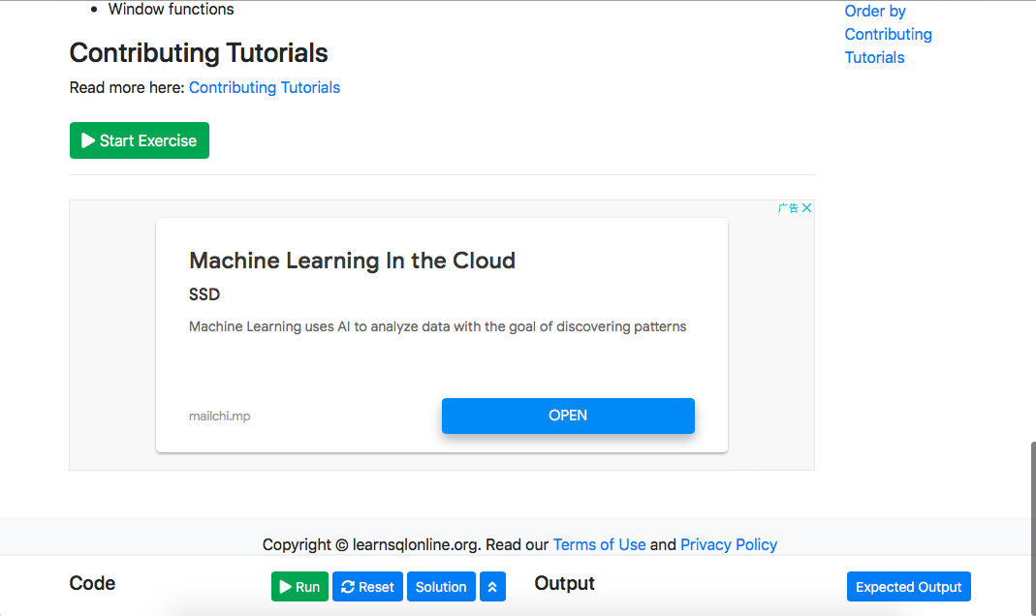
https://www.learnsqlonline.org
https://www.learnsqlonline.org
Click the arrows to start writing code

Slide 29
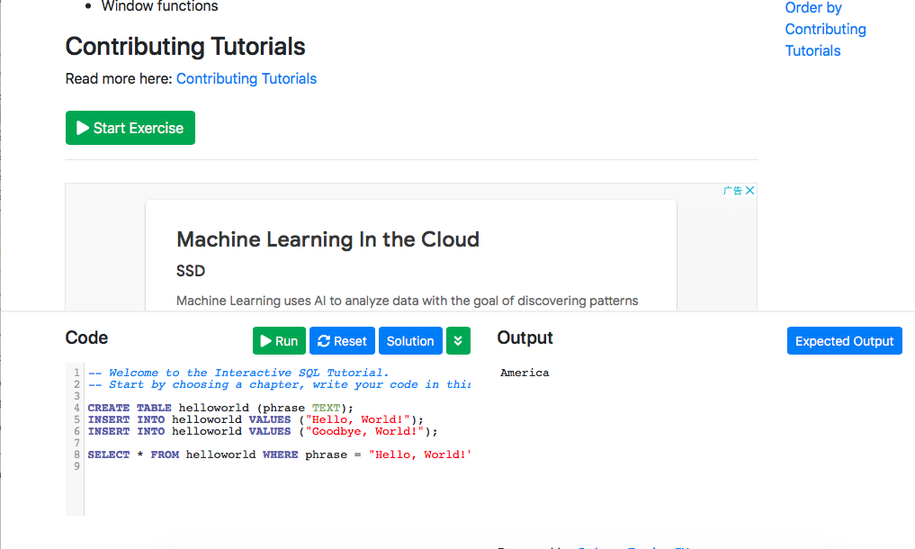
Just delete their rubbish

Slide 30
Create Database
CREATE DATABASE superhero;
******************* PLEASE NOTE, IN THE PAST I USED AN APP CALLED XAMPP AND THIS CODE WORKS FINE, BUT IN LEARNSQLONLINE.ORG IT DOES NOT ALLOW TO CREATE A DATABASE *******************

Slide 31
Create Table
So now I made a database (kind of) and now we will make a table
CREATE TABLE goodguys (
HeroID int,
LastName varchar(255),
FirstName varchar(255),
BestPower varchar(255),
BestMovie varchar(255)
);
The name of my table is goodguys int = Integer
Varchar = string / text
(255) = how many letters can that varchar have

Slide 32
Add information
INSERT INTO goodguys VALUES (1, "America", "Captain", "Strength", "Winter Soldier");

Slide 33
So we have:
Made a database (but the website won’t allow this)
Made a table
Given the table some information
CREATE DATABASE superhero
CREATE TABLE goodguys (
HeroID int,
LastName varchar(255),
FirstName varchar(255),
BestPower varchar(255),
BestMovie varchar(255)
);
INSERT INTO goodguys VALUES (1, "America", "Captain", "Strength", "Winter Soldier");

Slide 34
But now we want to get information from our table:
I want to find the Last Name of the person who has the HeroID = 1
But you need to say what field you want, what table you want it from and where you want it from
SELECT LastName
FROM goodguys
WHERE HeroID = 1;

Slide 35
Get all the information
What if you wanted all the information?
SELECT *
FROM goodguys;
The * = Means everything
What if I have 5 people in my table and I want everything from person 3?
SELECT *
FROM goodguys;
WHERE HeroID = 3

Slide 36
Update Information
To update information, we have to say what table to update, what field to update, where to update
UPDATE goodguys
SET LastName= "Rogers"
WHERE HeroID=1;
But this will just update your table, it won’t display anything. To display something you need:
SELECT LastName FROM goodguys WHERE HeroID = 1;

Slide 37
Sort Information
You may want to show my data and sort it in order.
CREATE TABLE goodguys
(
HeroID int,
LastName varchar(255),
FirstName varchar(255),
BestPower varchar(255),
BestMovie varchar(255)
);
INSERT INTO goodguys VALUES (1, "America", "Captain", "Strength", "Winter Soldier");
INSERT INTO goodguys VALUES (2, "Stark", "Tony", "Smart", "Iron Man");
INSERT INTO goodguys VALUES (3, "Wayne", "Bruce", "Rich", "Batman");
INSERT INTO goodguys VALUES (4, "Wonder", "Woman", "Honesty", "Wonder Woman");
So lets say I want to have all their First names in order

Slide 38
Sort in order of FirstName
So I have this in my table:
INSERT INTO goodguys VALUES (1, "America", "Captain", "Strength", "Winter Soldier");
INSERT INTO goodguys VALUES (2, "Stark", "Tony", "Smart", "Iron Man");
INSERT INTO goodguys VALUES (3, "Wayne", "Bruce", "Rich", "Batman");
INSERT INTO goodguys VALUES (4, "Wonder", "Woman", "Honesty", "Wonder Woman");
To display and sort them:
SELECT FirstName FROM goodguys ORDER BY FirstName Asc;
What if I want to show their FirstName but I want it in order of their Best Movie?
SELECT FirstName FROM goodguys ORDER BY BestMovie Asc;
Asc = Ascending order (Smallest to biggest or A-Z or 0 – 9)

Slide 39
Overview so far
CREATE TABLE goodguys (
HeroID int,
LastName varchar(255),
FirstName varchar(255),
BestPower varchar(255),
BestMovie varchar(255)
);
INSERT INTO goodguys VALUES (1, "America", "Captain", "Strength", "Winter Soldier");
INSERT INTO goodguys VALUES (2, "Stark", "Tony", "Smart", "Iron Man");
INSERT INTO goodguys VALUES (3, "Wayne", "Bruce", "Rich", "Batman");
INSERT INTO goodguys VALUES (4, "Wonder", "Woman", "Honesty", "Wonder Woman");
SELECT LastName FROM goodguys WHERE HeroID = 1;
UPDATE goodguys
SET LastName= "Rogers"
WHERE HeroID=1;
SELECT LastName FROM goodguys WHERE HeroID = 1;
SELECT *
FROM goodguys;
WHERE HeroID = 3
SELECT FirstName FROM goodguys ORDER BY BestMovie Asc;

Slide 40
Task 1:
What do these words do?
Create a tutorial video that shows how to use:
FROM
WHERE
ORDER BY
GROUP BY
INNER
JOIN
SUM
COUNT
AVG
DESC
INSERT INTO
DELETE FROM
UPDATE

Slide 41
Task 2:
Create a database
Create a table called “Students”
It should have:
Student ID number (you can make this up)
Student Last Name
Student First Name
Date of birth
Male or Female
Last 5 digits of their phone number
Insert 5 records of students
Update the last record to read “ID, Carter, Sam, 18/09/1983, Female, 90210
Create a primary key (ADDPRIMARY KEY)
Create a new table in the same database
Input 5 records of anything you wish as long as it has 6 attributes and one is gender
Search for all the females across both tables
Sort the search in descending order
Create a foreign key

